Slide 1
Fundamental Programming in JAVA
Predefined Classes & User defined methods

Slide 2
Objectives
Solve mathematics problems by using the methods in the Math class.
Represent strings using the String objects.
Perform operations on String objects such as trimming ,concatenating, comparing, replacing strings etc.
Define methods with formal parameters.
Invoke methods with actual parameters.
Define methods with a return value.
Define methods without a return value.
Pass arguments by value.

Slide 3
The String Class
Java has no primitive data type that holds a series of characters.
The String class from the Java standard library is used for this purpose.
In order to be useful, the a variable must be created to reference a String object.
Eg. String number;
Notice the S in String is upper case.
By convention, class names should always begin with an upper case character.

Slide 4
Primitive vs. Reference Variables
Primitive variables actually contain the value that they have been assigned.
Eg. int number = 25;
The value 25 will be stored in the memory location associated with the variable number.
Objects are not stored in variables, however. Objects are referenced by variables.

Slide 5
Primitive vs. Reference Variables
When a variable references an object, it contains the memory address of the object’s location.
Then it is said that the variable references the object.
Eg. String cityName = “Amman";
The variable (cityName)
that contains the
Memory Address (references)
to the object
The object that contains the
string “Amman”
Amman
cityName
9304b1
9304b1

Slide 6
String Objects
A variable can be assigned a String literal. String value1 = “Welcome to Java";
Strings are the only objects that can be created in this way.
A variable can be created using the new keyword. String value2 = new String("Java Programming");
This is the method that all other objects must use when they are created.

Slide 7
Strings Are Immutable
A String object is immutable; its contents cannot be changed. Does the following code change the contents of the string? String s = "Java"; s = "HTML";

Slide 8
Trace Code (Two Slides)
String s = "Java";
s = "HTML";
Code in Orange First

Slide 9
Cont. Trace Code
String s = "Java";
s = "HTML";
Code in Blue After

Slide 10
Interned Strings
Since strings are immutable and are frequently used, to improve efficiency and save memory, the JVM uses a unique instance for string literals with the same character sequence. Such an instance is called interned. For example, the following statements:

Slide 11
Examples
A new object is created if you use the new operator.
If you use the string initializer, no new object is created if the interned object is already created.
display
s1 == s2 is false
s1 == s3 is true

Slide 12
Trace Code (Three Slides)
Code in Blue First

Slide 13
Cont. Trace Code
Code in Red Now

Slide 14
Cont. Trace Code
Code in Green Now

Slide 15
String Methods
The String class contains many methods that help with the manipulation of String objects.
String objects are immutable, meaning that they cannot be changed.
Many of the methods of a String object can create new versions of the object.

Slide 16
Simple Methods for String Objects

Slide 17
Getting String Length
String message = "Welcome to Java";
System.out.println("The length of " + message + " is "
+ message.length());

Slide 18
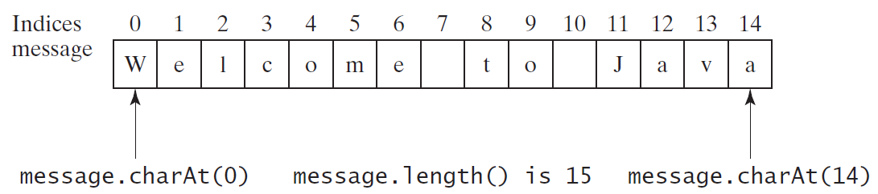
Getting Characters from a String
String message = "Welcome to Java";
System.out.println("The first character in message is " + message.charAt(0));

Slide 19
Converting Strings
"Welcome".toLowerCase() //returns a new string, welcome.
"Welcome".toUpperCase() //returns a new string, WELCOME.
" Welcome ".trim() //returns a new string, Welcome.

Slide 20
String Concatenation
String s3 = s1.concat(s2); or String s3 = s1 + s2; // Three strings s1, s2 concatenated and assigned to s3
String message = "Welcome " + "to " + "Java"; // Three strings are concatenated
String s = "Chapter" + 2; // String Chapter is concatenated with number 2, s becomes Chapter2
String s1 = "Supplement" + 'B’; // String Supplement is concatenated with character B s1 becomes SupplementB

Slide 21
Comparing Strings
Examples
Outputs :
s1 == s2 is false
s1 == s3 is true
s1.equals(s2) is true
s1.equals(s3) is true
s1.equalsIgnoreCase(s4) is true

Slide 22
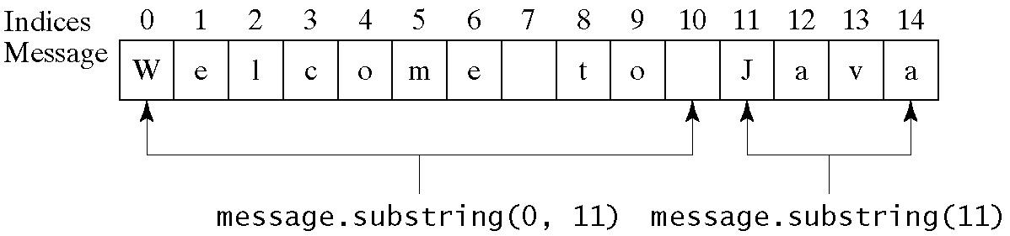
Obtaining Substrings

Slide 23
Finding a Character or a Substring in a String

Slide 24
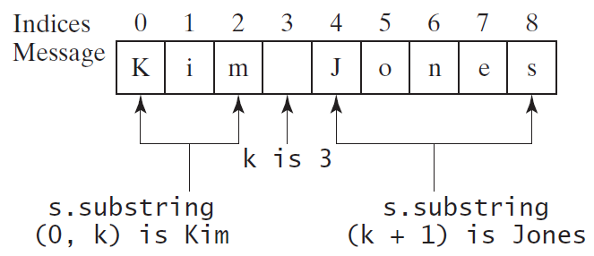
Finding a Character or a Substring in a String
int k = s.indexOf(' ');
String firstName = s.substring(0, k);
String lastName = s.substring(k + 1);

Slide 25
The Math Class
The Math class provides a number of standard mathematical methods
It is found in the java.lang package, so it does not require an import statement
Class constants:
PI = 3.141592653589793
E = 2.718281828459045
Class methods:
Trigonometric Methods
Exponent Methods
Rounding Methods
min, max, abs, and random Methods

Slide 26
Exponent Methods
pow(double a, double b) //Returns a raised to the power of b.
sqrt(double a) //Returns the square root of a.
Examples:
Math.pow(2, 3);// returns 8.0
Math.pow(3, 2);// returns 9.0
Math.pow(3.5, 2.5);// returns 22.91765
Math.sqrt(4);// returns 2.0
Math.sqrt(10.5);// returns 3.24

Slide 27
min, max, and abs
max(a, b)and min(a, b) //Returns the maximum or minimum of two parameters.
abs(a)//Returns the absolute value of the parameter.
random() //Returns a random double value //in the range [0.0, 1.0).
Examples:
Math.max(2, 3); //returns 3
Math.max(2.5, 3); //returns 3.0
Math.min(2.5, 3.6); //returns 2.5
Math.abs(-2); //returns 2
Math.abs(-2.1); //returns 2.1

Slide 28
The random Method
Generates a random double value greater than or equal to 0.0 and less than 1.0 (0 <= Math.random() < 1.0).

Slide 29
Examples on random Method
For example:
int x = (50 + Math.random( )*50);
//returns a random number between 50 and 100, exclude (50 and 100) and store it in x
System.out.println(0 + Math.random( )*10);
// returns a random number between 0 and 10 exclude (0 and 10) and print it
double d = 50 + (int) (Math.random( )*50);
// returns a random integer number starting from 50 to 99 (50 and 99 inclusive) and stores it in d

Slide 30

Exercises
Q: Write a java program to solve the following equations:
a=3 , b=1.5, x is integer.
Q: Find the maximum number of 35, 10 , 62 .
Q: Write a java program that declares a String variable message=“Welcome to Java”, and generates an integer random number between 0 and length of that String. Then prints the character at that random number.

Slide 31
Exercises
Q: write a program to print a user name, if the name consists of more than 7 characters.
Q: write a program to compute the area of a circle, if the radius is more than or equals to 2.5 where the radius should be entered as string ?
Q: write a program to print “your name contains letter R” if the user name contains letter R.
Q: Write a program to prompt a user to enter his name, and print "your name is too short" if the user name is less than or equals 5 characters, otherwise print "your name has more than 5 characters" , using SWITCH.

Slide 32
Exercises
Q: Write a Java program to compare two strings lexicographically, ignoring case differences.
Sample Output:
String 1: This is exercise 1
String 2: This is Exercise 1
"This is exercise 1" is equal to "This is Exercise 1"

Slide 33
Exercises
Write a Java program to test if a given string contains the specified sequence of char values.
Sample Output:
Original String: PHP Exercises and Python Exercises Specified sequence of char values: “and”
true

Slide 34
User Defined Methods
User-Defined Methods are methods that are created by the user based on some requirements.
Benefits of Methods:
Break a problem down into small manageable pieces. This is called divide and conquer.
Write a method once and reuse it anywhere.
Information hiding. Hide the implementation from the user.
Reduce complexity.
A method in Java is equivalent to a function, procedure, or subroutine in other languages.

Slide 35
Defining Methods
A method is a collection of statements that are grouped together to perform an operation.

Slide 36
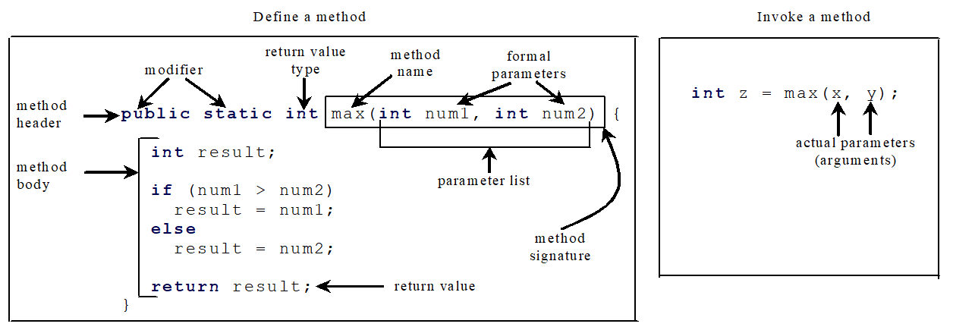
Defining Methods
A method is a collection of statements that are grouped together to perform an operation.

Slide 37
Method Signature
Method signature is the combination of the method name and the parameter list.

Slide 38
Formal Parameters
The variables defined in the method header are known as formal parameters.

Slide 39
Actual Parameters
When a method is invoked, you pass a value to the parameter. This value is referred to as actual parameter or argument.

Slide 40
Return Value Type
A method may return a value. The returnValueType is the data type of the value the method returns. If the method does not return a value, the returnValueType is the keyword void. For example, the returnValueType in the main method is void.

Slide 41
Code Tracing(10 Slides)
i is now 5

Slide 42
Code Tracing(10 Slides)
j is now 2

Slide 43
Code Tracing(10 Slides)
invoke max(i, j)

Slide 44
Code Tracing(10 Slides)
invoke max(i, j)
Pass the value of i to num1
Pass the value of j to num2

Slide 45
Code Tracing(10 Slides)
declare variable result

Slide 46
Code Tracing(10 Slides)
(num1 > num2) is true since num1 is 5 and num2 is 2

Slide 47
Code Tracing(10 Slides)
Result is now 5

Slide 48
Code Tracing(10 Slides)
return max(i, j) and assign the return value to k

Slide 49
Code Tracing(10 Slides)
Execute the print statement

Slide 50
CAUTION
A return statement is required for a value-returning method. The method shown below in (a) is logically correct, but it has a compilation error because the Java compiler thinks it possible that this method does not return any value.

Slide 51
Value-returning Methods
A value-returning method is one that simply performs a task and then sends a value back to the code that called it.
Used in expressions.
Can save value for later calculation or print value.
public static double min(double x, double y)
{ if (x <= y)
return x;
return y; }

Slide 52
void Methods
A void method is one that simply performs a task and then terminates.
Similar in structure to value-returning methods.
Call to method is always stand-alone statement.
Can use return statement to exit method early.
public static void displayValue(int num)
{
System.out.println("The value is " + num);
}

Slide 53
Passing Arguments by value
In Java, all arguments of the primitive data types are passed by value, which means that only a copy of an argument’s value is passed into a parameter variable.
A method’s parameter variables are separate and distinct from the arguments that are listed inside the parentheses of a method call.
If a parameter variable is changed inside a method, it has no affect on the original argument.
PassByValue.java

Slide 54
Passing Arguments by value
The value 5.0 of argument n1 is copied into the num1 parameter.
The value 10.0 of argument n2 is copied into the num2 parameter.
double n1=5.0, n2=10.0
showSum(n1, n2);
public static void showSum(double num1, double num2)
{
double sum; //to hold the sum
sum = num1 + num2;
System.out.println("The sum is " + sum);
}
NOTE: Order matters!

Slide 55
The static key word
If a method is declared static, it can be accessed from the class itself without a need to create an object of that class.

Slide 56
Exercise(1)
Write a Java method to find the smallest number among three numbers.
Write a Java program that includes a method named isOddEven to determine whether a given integer is odd or even. Prompt the user to enter a whole number, call the isOddEven method to check its parity, and then print a message indicating whether the entered number is odd or even. Ensure that your program provides clear user instructions and outputs a meaningful result based on the parity of the entered number.

Slide 57
Exercise(2)
write a program to find the area of a rectangle, as following:
Define a method to read the width and height of a rectangle.
Define a method to calculate the area.
Define a method to print the area.

Slide 58
Exercise(3)
Write a program to find the factorial of a number using two methods: one method called input to get the input from the user and return it as integer, and the second called fact which computes and prints the factorial.
Write a java method that prompts the user to input a positive integer. It should then print the multiplication table of that number.

Slide 59
Exercise(4)
Write a java method to find the value of one number raised to the power of another (x^{y}).
Write a program to find the average of three marks for a student, as following:
Define a method named getMark to read the value of each mark, and returns it as int.
Define a method named findAvg to compute the average for the student.

Slide 60
Exercise(5)
Write a java method named findVol to find the volume the volume of a cylinder, where: cylinderVolume=πr²h, Where π is constant and the values of h and r should be received as a parameters
Write a java method called display() to print the even numbers in a range between x and y. where x and y should be entered by user.

Slide 61
Exercise(6)
Write Java program that prompts the user to input two integers, a starting number and an ending number. It then uses a while loop to print all the natural numbers from the starting number to the ending number, inclusive.

Slide 62
Reference
[1] Introduction to Java Programming, Comprehensive Version, Student Value Edition, Daniel Liang, 12th Edition, Pearson 2019
lecture Notes: edugate.asu.edu.jo.
lecture Videos : YouTube channel.
Lab manual 2,3,4,7

